Slide 1
Machine Learning AIML CZG565
M4 : Linear Models for Classification
Course Faculty of MTech Cluster
BITS – CSIS - WILP

Slide 2

Machine Learning
Disclaimer and Acknowledgement
These content of modules & context under topics are planned by the course owner Dr. Sugata, with grateful acknowledgement to many others who made their course materials freely available online
We here by acknowledge all the contributors for their material and inputs.
We have provided source information wherever necessary
Students are requested to refer to the textbook w.r.t detailed content of the presentation deck shared over canvas
We have reduced the slides from canvas and modified the content flow to suit the requirements of the course and for ease of class presentation
Slide Source / Preparation / Review:
From BITS Pilani WILP: Prof.Sugata, Prof.Chetana, Prof.Rajavadhana, Prof.Monali, Prof.Sangeetha, Prof.Swarna, Prof.Pankaj
External: CS109 and CS229 Stanford lecture notes, Dr.Andrew NG and many others who made their course materials freely available online

Slide 3
Recap
Classification
Output is discrete e.g. f(x) : {yes, no, maybe}
f(x) : {0, 1} or {yes, no} Binary Classification
Ojective: minimize mis-classification rate
Two kinds of Classifiers:
Probabilistic Generative Classifiers
Models aim to learn joint probability distribution P(X, Y)
Probabilistic Discriminative Classifiers
Models learn the decision boundary that separate the two classes

Slide 4
Logistic Regression
AGENDA

Slide 5
Logistic Regression
statistical model used for binary classification problems,
goal is to predict the probability that a given input belongs to one of two classes.
uses the logistic function to model the relationship between the input variables (also known as predictors or features) and the output variable (also known as the response or target)
MODEL:
z = woxo + w1 x1 + …. + wnxn
hz(x) = 1/ 1 + e^ -z

Slide 6

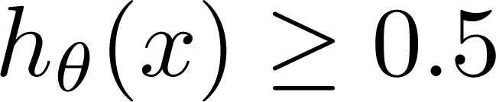
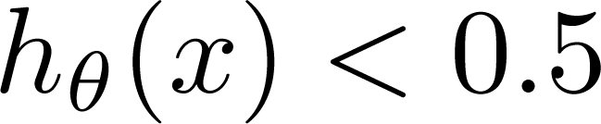
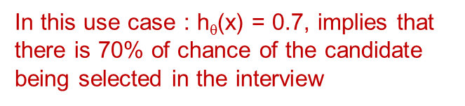
Job Offered ?
Logistic Regression vs Least Squares Regression
Figure depicts sample data points
(Yes) 1
(No) 0
CGPA or IQ
Independent Attribute : CGPA or IQ
Can we solve the problem using linear regression? E.g., fit a straight line and define a threshold at 0.5
Threshold classifier output h_{θ}(x) at 0.5:
A Discriminant function f (x)
directly map input to class labels
In two-class problem, f (.) is binary valued
If
If
, predict “y = 1”
, predict “y = 0”

Slide 7
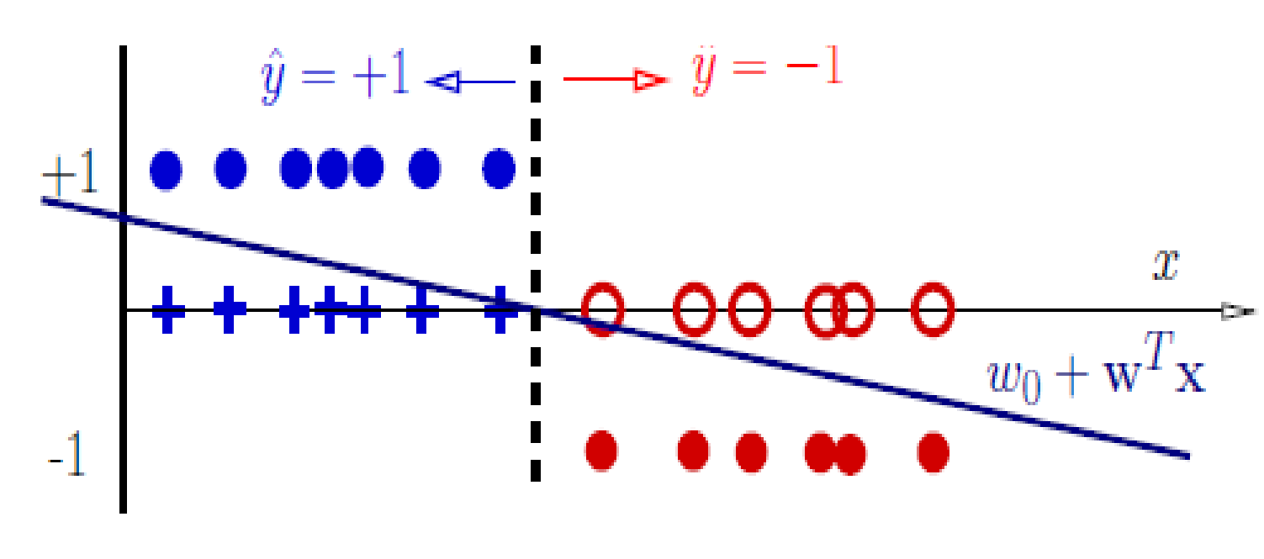
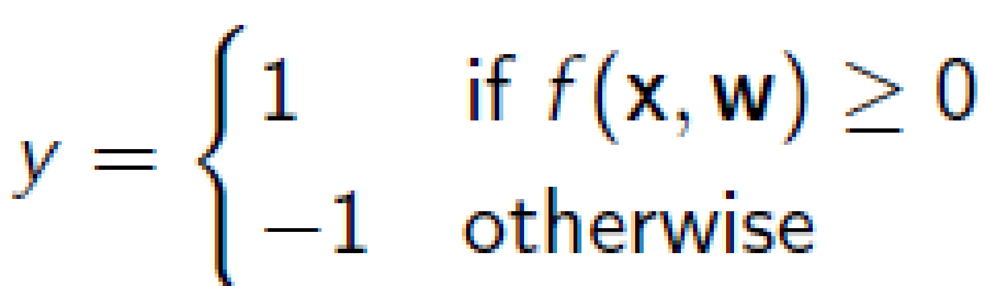
Decision Rules
Classifier:
f (x, w) = w_{o} + w^{T} x (linear discriminant function)
Decision rule is
Mathematically
y = sign(w₀ + w^{T} x)
This specifies a linear classifier: it has a linear boundary (hyperplane)
w₀ + w^{T} x = 0
A discriminant is a function that takes an input vector x and assigns it to one of K classes, denoted C_{k}.

Slide 8

Logistic Regression vs Least Squares Regression
(Yes) 1
Job Offered ?
(No) 0
CGPA or IQ
Failure due to adding a new point

Slide 9
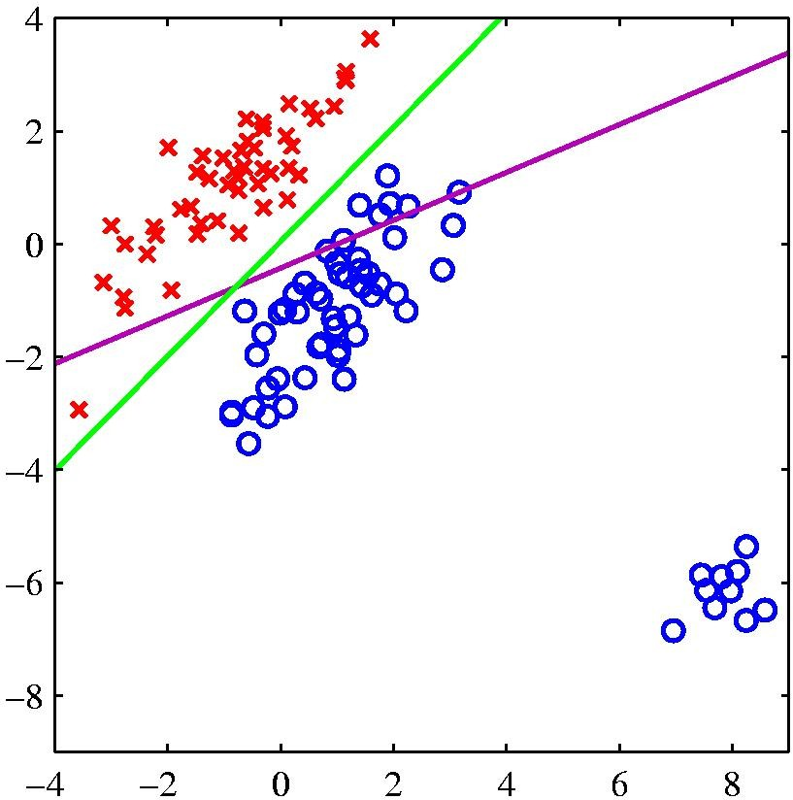
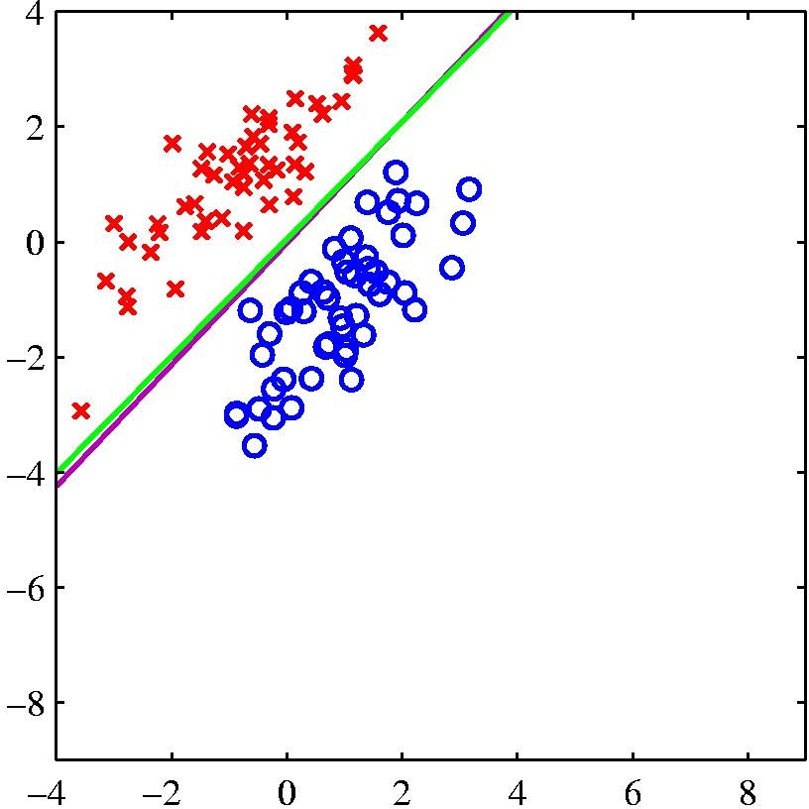
Logistic Regression vs Least Squares Regression
logistic regression
least squares regression
The right-hand plot shows the corresponding results obtained when extra data points are added at the bottom left of the diagram, showing that least squares is highly sensitive to outliers, unlike logistic regression.

Slide 10
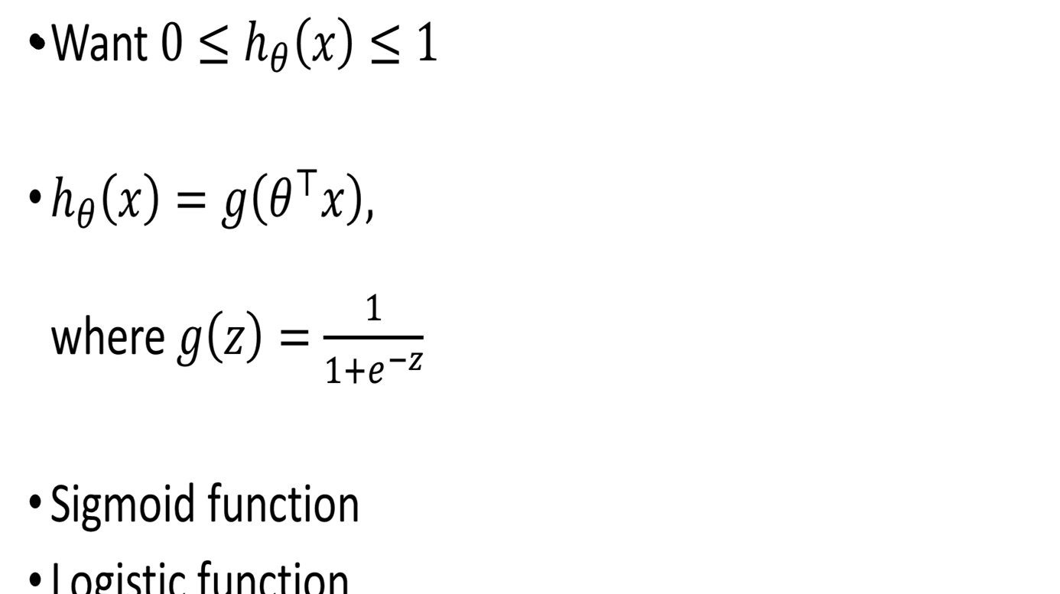
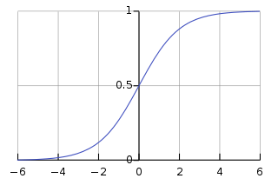
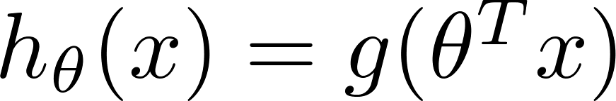
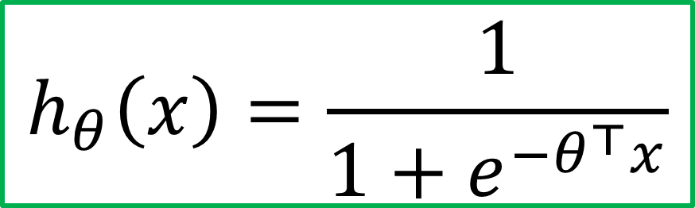
Sigmoid Function
Sigmoid/logistic function takes a real value as input and outputs another value between 0 and 1
That framework is called logistic regression
Logistic: A special mathematical sigmoid function it uses
Regression: Combines a weight vector with observations to create an answer

Slide 11
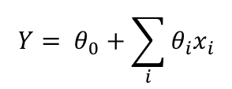

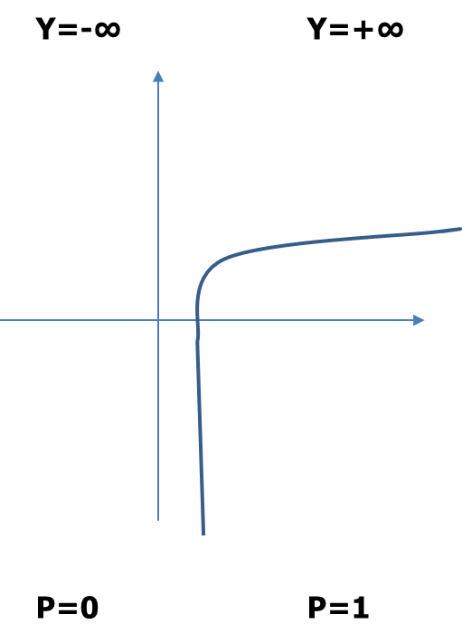
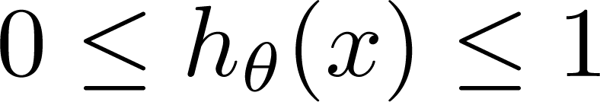
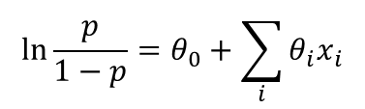
Classification: y = 0 or 1 h_{θ}(x) can be > 1 or < 0 What we need:
Logistic Regression vs Least Squares Regression
Another drawback of using linear regression for this problem

Slide 12
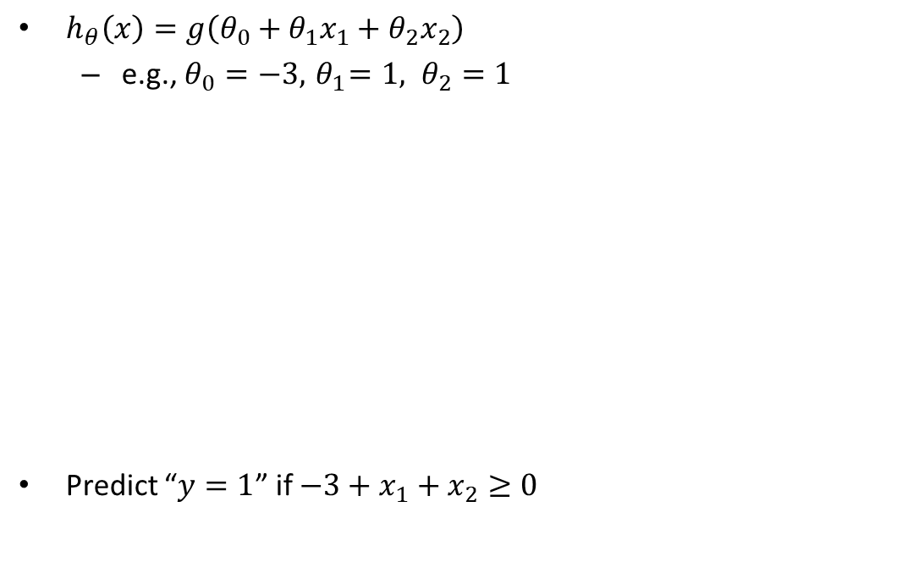
Logistic Regression – Sample Linear Boundary
At decision boundary output of logistic regression is 0.5
Figure depicts sample data points
Decision boundary
IQ
CGPA
Slide credit: Andrew Ng

Slide 13
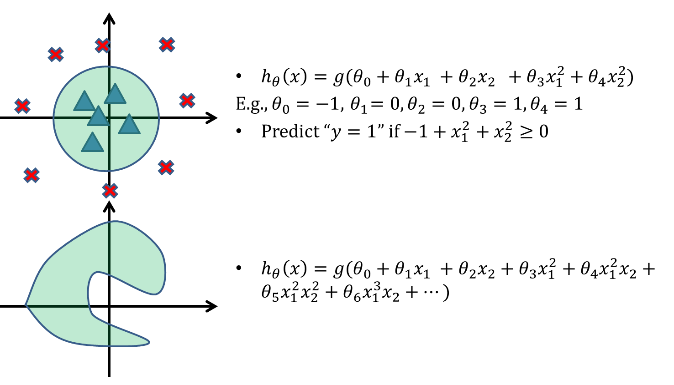
Logistic Regression – Sample Non-Linear Boundary
IQ
CGPA
Figure depicts sample data points
CGPA
IQ
Slide credit: Andrew Ng

Slide 14
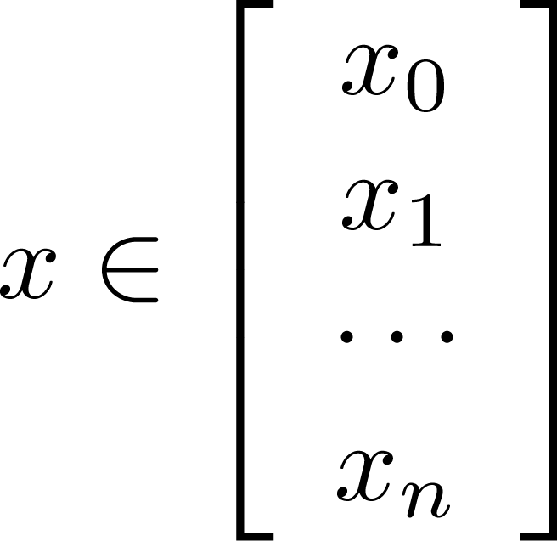
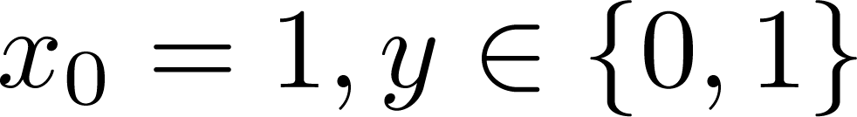
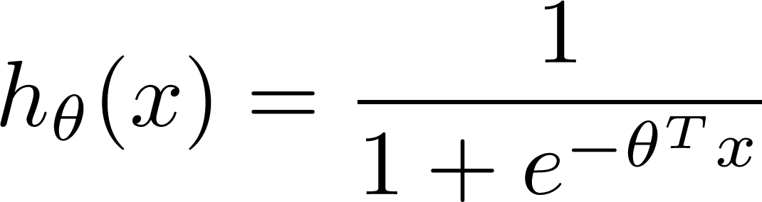
Learning model parameters
Training set:
m examples
How to choose parameters (feature weights) ?

Slide 15
Notion of Cost Function in Classification

Slide 16


Logistic Regression
Training set:
How to choose parameters (feature weights)?
“non-convex”
“convex”

Slide 17
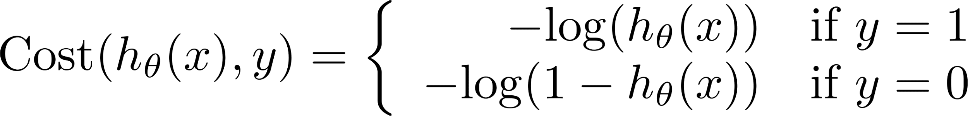
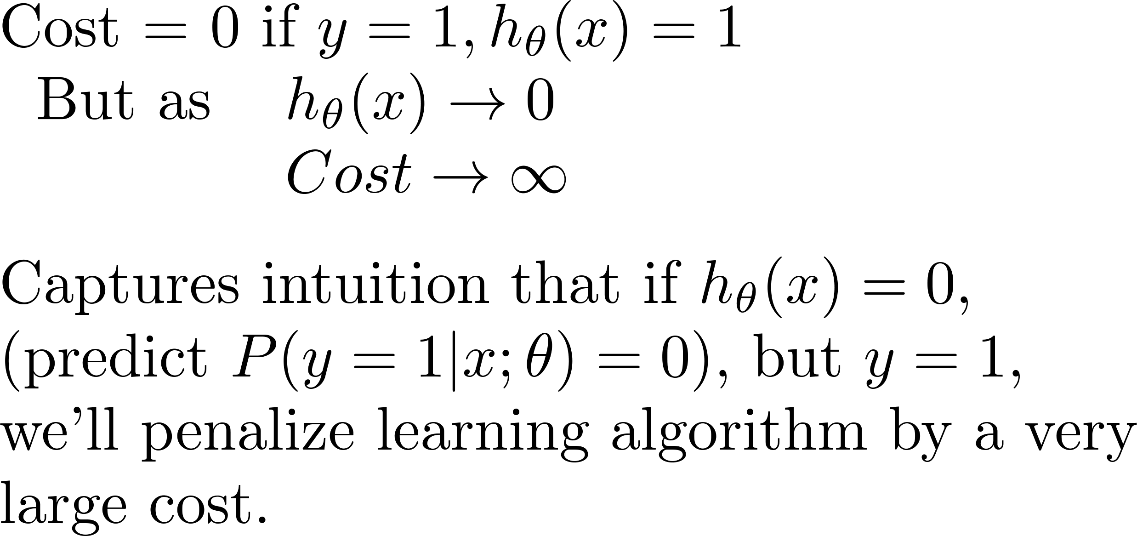
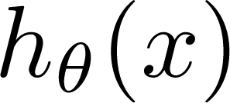
Logistic regression cost function (cross entropy)
If y = 1
ie.,
Actual Value Job Offered = 1
Cost
0
1
Predicted Value
Job Offered = 1
Predicted Value
Job Offered = 0

Slide 18
Logistic regression cost function
If y = 0
ie.,
Actual Value
Job Offered = 0
Cost=0; If y=0 and h_{Ꝋ}(x)=0
Cost
0
Predicted Value
Job Offered = 1
Predicted Value
Job Offered = 0
1

Slide 19
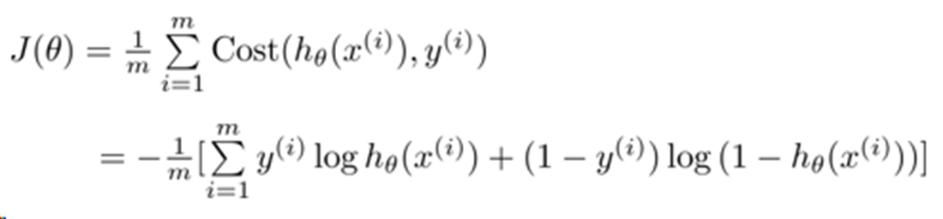

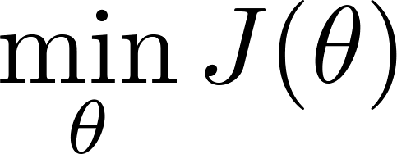
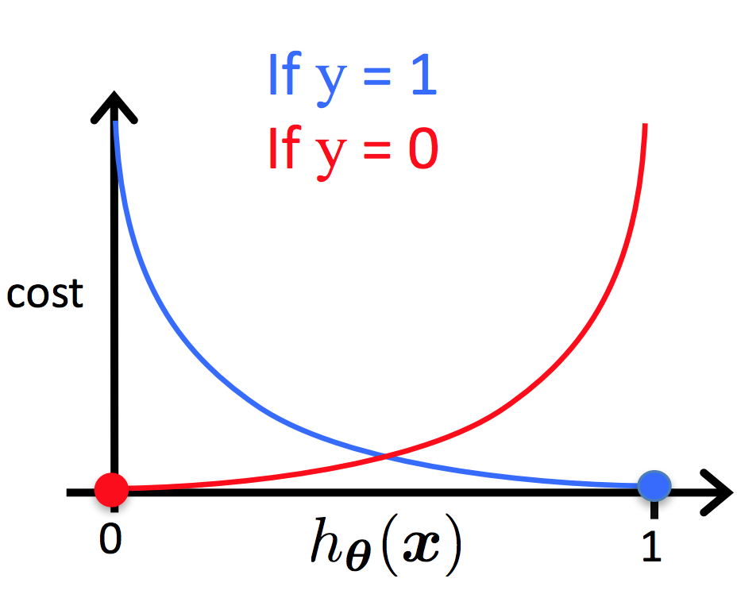

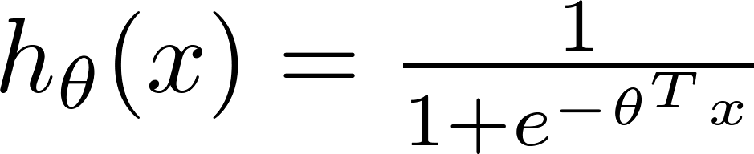
Cost function
To fit parameters : Apply Gradient Descent Algorithm
To make a prediction given new :
Output :

Slide 20
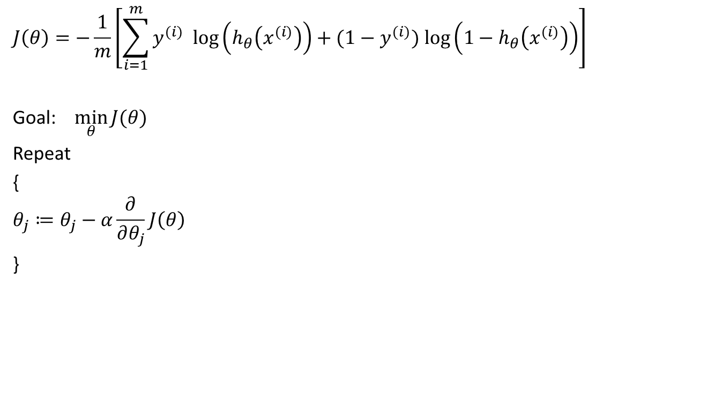
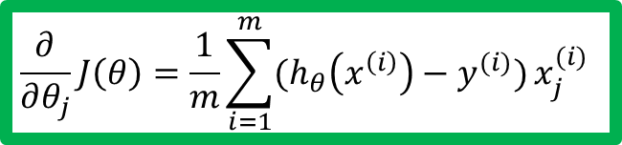
Gradient Descent Algorithm

Slide 21
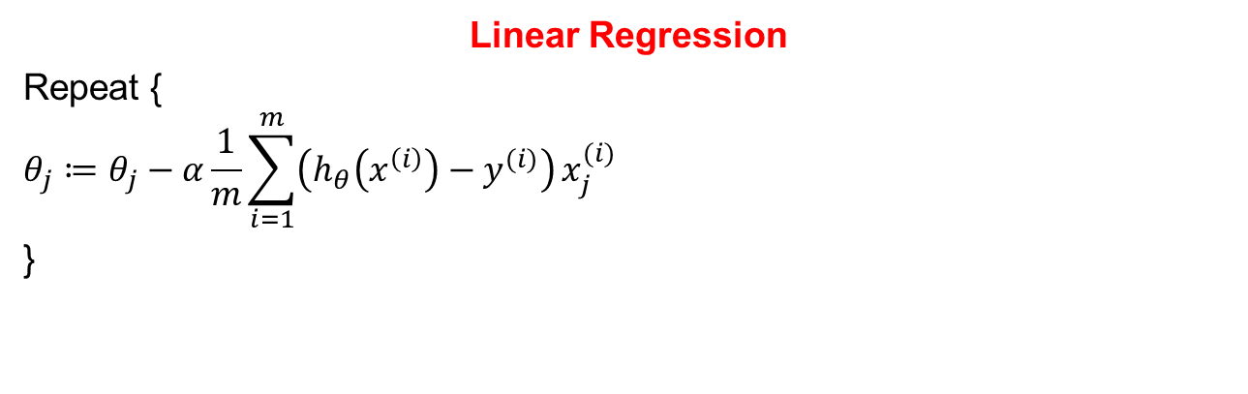

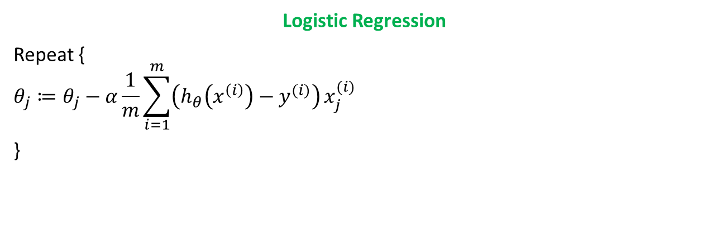
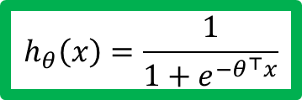
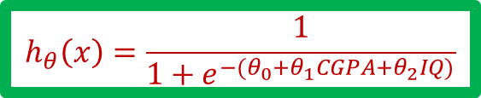
Gradient Descent Algorithm

Slide 22
Application of Logistic Regression & Problem Types

Slide 23
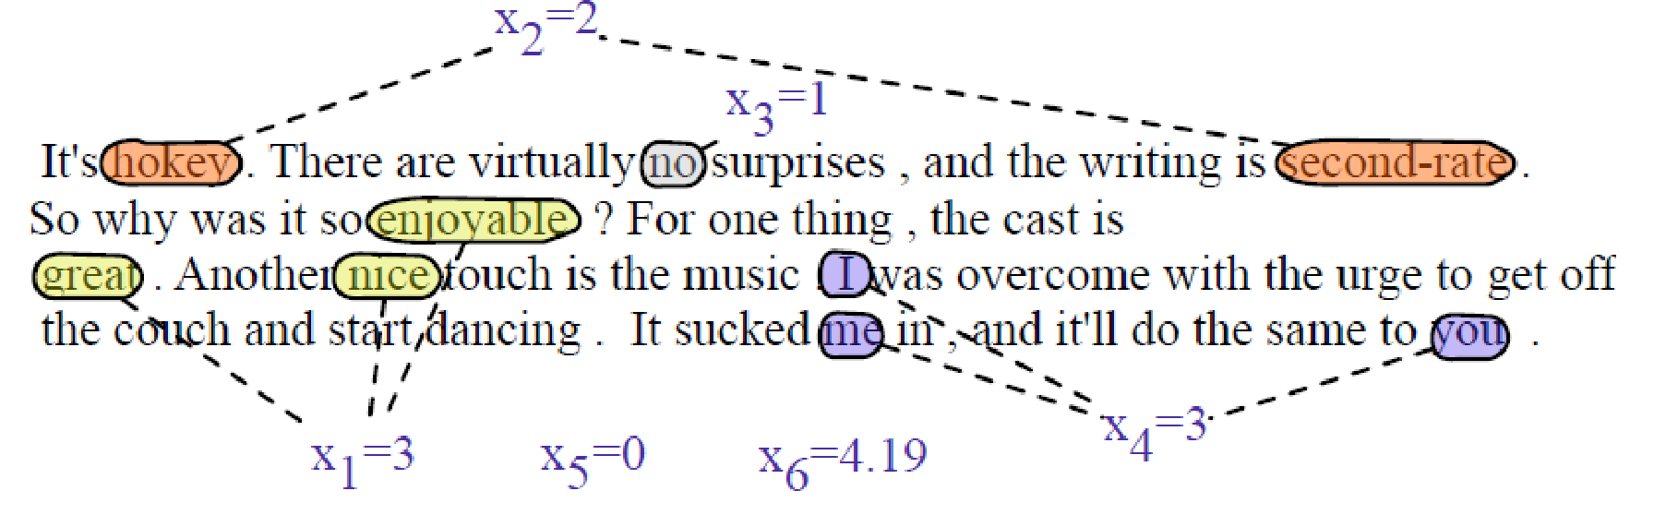
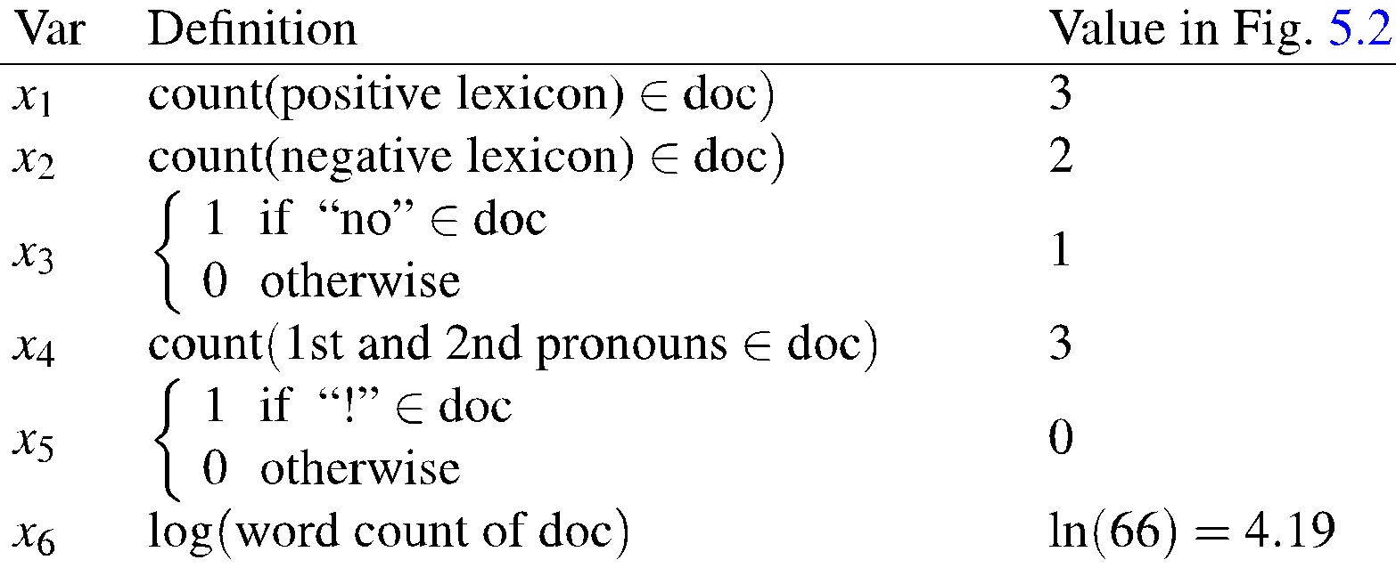
Example: Sentiment Analysis – With Engineered features
Sentiment Features

Slide 24
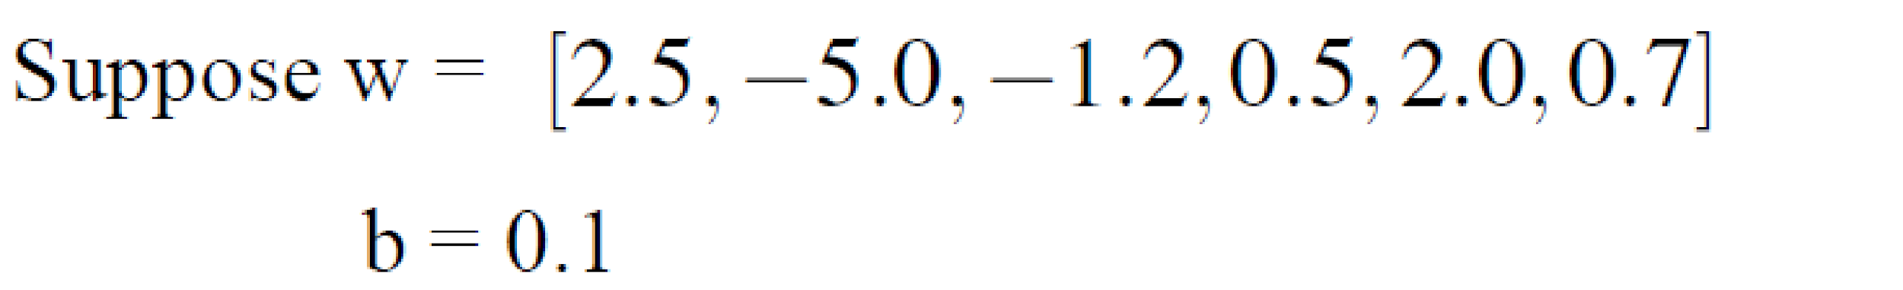
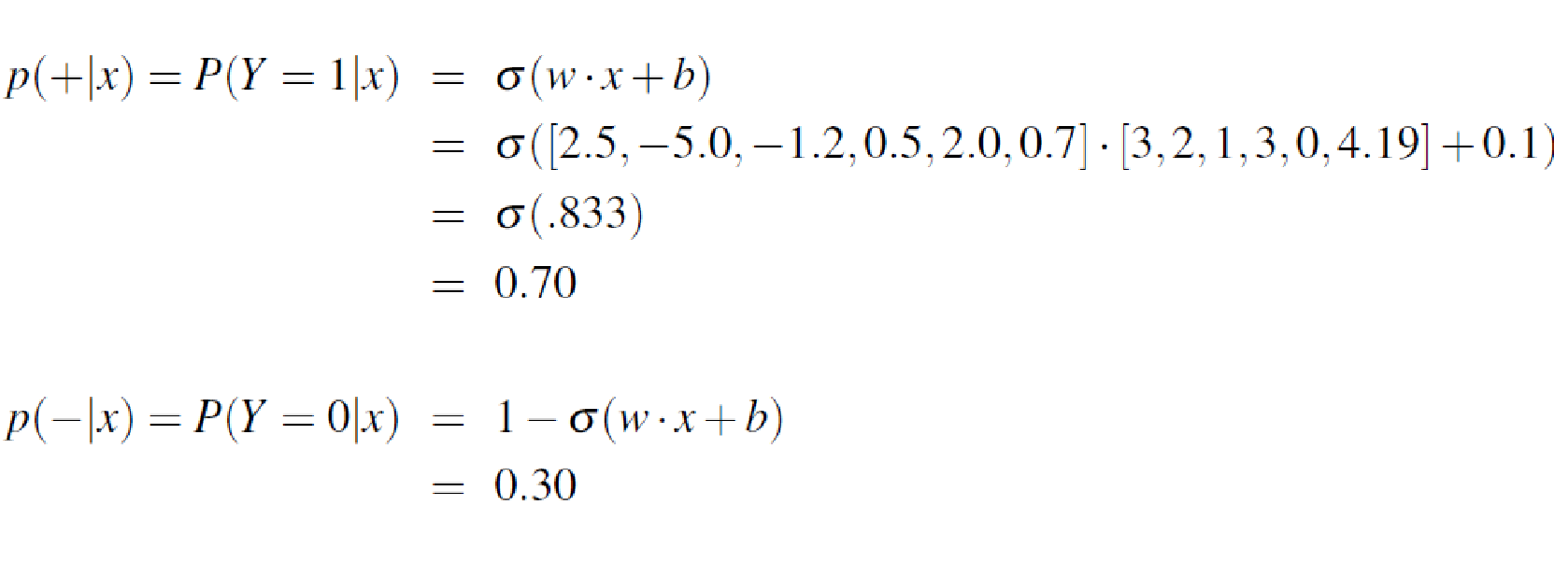
Classifying sentiment using logistic regression

Slide 25
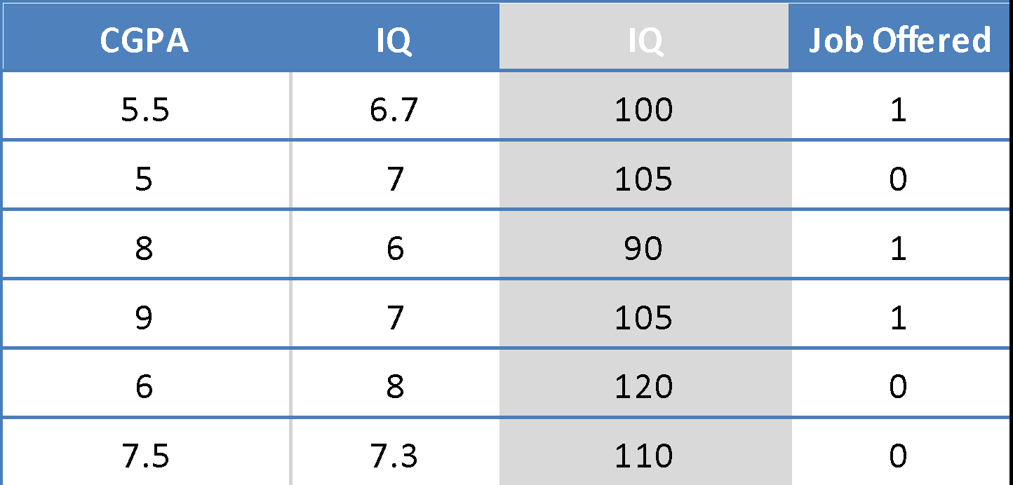

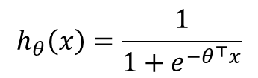
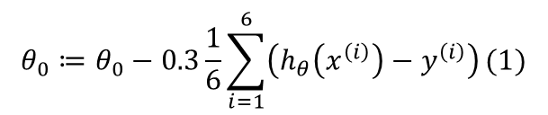
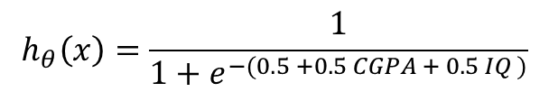
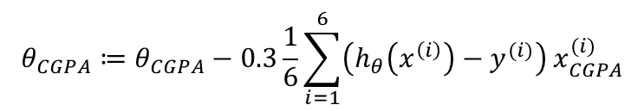
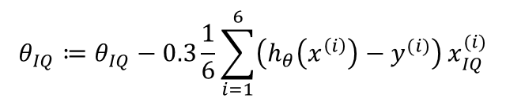
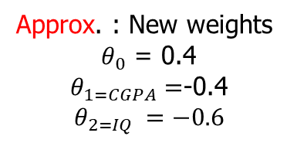
Logistic Regression – Fit a Model – Apply Gradient Descent
Hyper parameters:
Learning Rate = 0.3
Initial Weights = (0.5, 0.5,0.5)
Regularization Constant = 0

Slide 26
Logistic Regression – Inference & Interpretation
Assume : 0.4+0.3CGPA-0.45IQ
Predict the Job offered for a candidate : (5, 6)
h(x) = 0.31
Y-Predicted = 0 / No
Note :
The exponential function of the regression coefficient (e^{w-cpga}) is the odds ratio associated with a one-unit increase in the cgpa.
+ The odd of being offered with job increase by a factor of 1.35 for every unit increase in the CGPA [np.exp(model.params)]

Slide 27
Regularization Note : This topic is already covered in the module 3 and the implementation remains the same. Only one points added here w.r.t interpretation for logistic regression

Slide 28
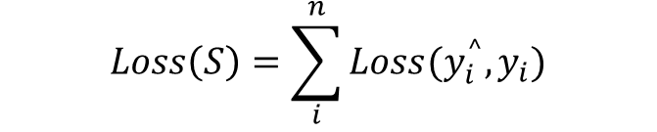
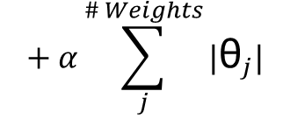
Ways to Control Overfitting – Interpretation of Hyper parameter
Regularization
Note:
The hyperparameter controlling the regularization strength of a Scikit-Learn LogisticRegression model is not alpha (as in other linear models), but its inverse: C. The higher the value of C, the less the model is regularized.

Slide 29
Evaluation of Classifiers
Using Another Example

Slide 30
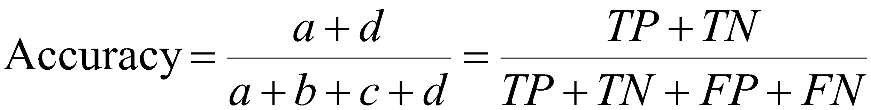
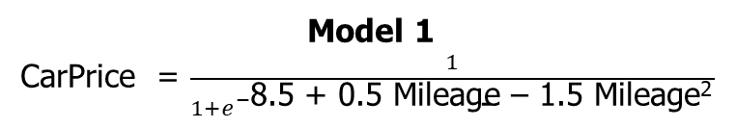
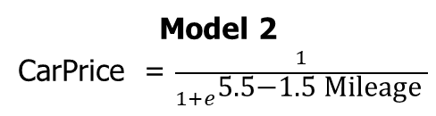
Evaluation of Classification Model Confusion Matrix
Mileage (in kmpl) | Car Price (in cr)
9.8 | High
9.12 | Low
9.5 | High
10 …. | Low …
 | PREDICTED CLASS
ACTUAL CLASS |  | Class= Low | Class= High
 | Class= Low | a (TP) | b (FN)
 | Class= High | c (FP) | d (TN)
Unseen Data
Mileage (in kmpl) | Car Price (in cr)
7.5 | High
10 | Low
…. | …..
Most effective when the class distribution is relatively balanced
Accuracy: 99%
Accuracy: 50%

Slide 31
Evaluation of Classification Model Confusion Matrix
 | PREDICTED CLASS
ACTUAL CLASS |  | Class= Low | Class= High
 | Class= Low | 0 (TP) | 10 (FN)
 | Class= High | 0 (FP) | 990 (TN)
 | PREDICTED CLASS
ACTUAL CLASS |  | Class= Low | Class= High
 | Class= Low | 10 (TP) | 0 (FN)
 | Class= High | 500 (FP) | 490 (TN)
If a model predicts everything to be class NO, accuracy is 990/1000 = 99 %. This is misleading because this trivial model does not detect any class YES example
Detecting the rare class is usually more interesting (e.g., frauds, intrusions, defects, etc)
Which model is better?
Accuracy: 99%
Accuracy: 50%

Slide 32
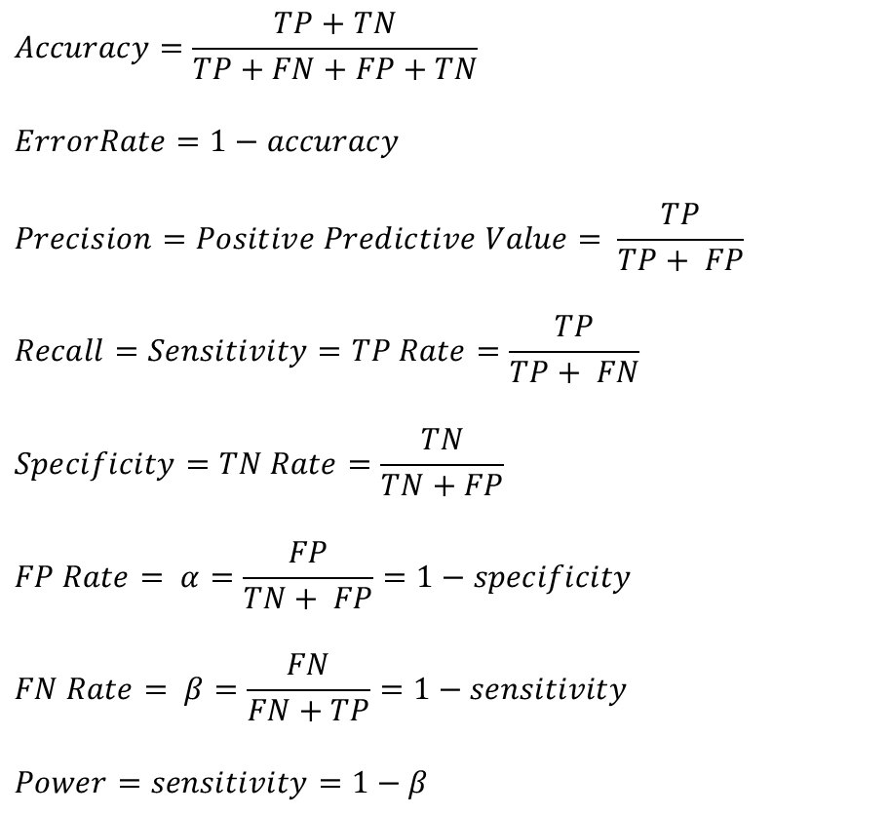

Evaluation of Classification Model Confusion Matrix
 | PREDICTED CLASS
ACTUAL CLASS |  | Class= Low | Class= High
 | Class= Low | a (TP) | b (FN)
 | Class= High | c (FP) | d (TN)

Slide 33






Which Classifier is better? Low Skew Case
T1 | PREDICTED CLASS
ACTUAL CLASS |  | Class=Yes | Class=No
 | Class=Yes | 50 | 50
 | Class=No | 1 | 99
T2 | PREDICTED CLASS
ACTUAL CLASS |  | Class=Yes | Class=No
 | Class=Yes | 99 | 1
 | Class=No | 10 | 90
T3 | PREDICTED CLASS
ACTUAL CLASS |  | Class=Yes | Class=No
 | Class=Yes | 99 | 1
 | Class=No | 1 | 99

Slide 34






Which Classifier is better? Medium Skew Case
T1 | PREDICTED CLASS
ACTUAL CLASS |  | Class=Yes | Class=No
 | Class=Yes | 50 | 50
 | Class=No | 10 | 990
T2 | PREDICTED CLASS
ACTUAL CLASS |  | Class=Yes | Class=No
 | Class=Yes | 99 | 1
 | Class=No | 100 | 900
T3 | PREDICTED CLASS
ACTUAL CLASS |  | Class=Yes | Class=No
 | Class=Yes | 99 | 1
 | Class=No | 10 | 990

Slide 35






Which Classifier is better? High Skew Case
T1 | PREDICTED CLASS
ACTUAL CLASS |  | Class=Yes | Class=No
 | Class=Yes | 50 | 50
 | Class=No | 100 | 9900
T2 | PREDICTED CLASS
ACTUAL CLASS |  | Class=Yes | Class=No
 | Class=Yes | 99 | 1
 | Class=No | 1000 | 9000
T3 | PREDICTED CLASS
ACTUAL CLASS |  | Class=Yes | Class=No
 | Class=Yes | 99 | 1
 | Class=No | 100 | 9900

Slide 36
Which Model should you use?
 | False Positive Rate | False Negative Rate
Model 1 | 41% | 3%
Model 2 | 5% | 25%
Mistakes have different costs:
Disease Screening – LOW FN Rate
Spam filtering – LOW FP Rate
Conservative vs Aggressive settings:
The same application might need multiple tradeoffs

Slide 37

ROC (Receiver Operating Characteristic)
A graphical approach for displaying trade-off between detection rate and false alarm rate
Developed in 1950s for signal detection theory to analyze noisy signals
ROC curve plots TPR against FPR
Performance of a model represented as a point in an ROC curve
(TPR,FPR):
(0,0): declare everything to be negative class
(1,1): declare everything to be positive class
(1,0): ideal
Diagonal line:
Random guessing
Below diagonal line:
prediction is opposite of the true class

Slide 38


Receiver Operating Characteristic (ROC) Curve
ROC curve plots TPR and FPR, to graphically represent their trade-off
AUC represents degree or measure of separability. It tells how much model is capable of distinguishing between classes.
Higher the AUC, better the model is at predicting
Area Under Curve (AUC) of ROC – evaluates model performance on average
AUC of ROC = 1, for a perfect model
AUC of ROC = 0.5, if the model is random
For model comparison, AUC of ROC should be larger for the model to be
superior or better performing
Usage
Threshold selection
Performance assessment
Classifier comparison

Slide 39

ROC Curve Example
1-dimensional data set containing 2 classes (positive and negative)
Any points located at x > t is classified as positive
At threshold t:
TPR=0.5, FNR=0.5, FPR=0.12, TNR=0.88

Slide 40
How to Construct an ROC curve
Use a classifier that produces a continuous-valued score for each instance
The more likely it is for the instance to be in the + class, the higher the score
Sort the instances in decreasing order according to the score
Apply a threshold at each unique value of the score
Count the number of TP, FP, TN, FN at each threshold
TPR = TP/(TP+FN)
FPR = FP/(FP + TN)
Instance | Score | True Class
1 | 0.95 | +
2 | 0.93 | +
3 | 0.87 | -
4 | 0.85 | -
5 | 0.85 | -
6 | 0.85 | +
7 | 0.76 | -
8 | 0.53 | +
9 | 0.43 | -
10 | 0.25 | +

Slide 41



How to construct an ROC curve
Threshold >=
ROC Curve:

Slide 42

Using ROC for Model Comparison
No model consistently outperforms the other
M₁ is better for small FPR
M₂ is better for large FPR
Area Under the ROC curve (AUC)
Ideal:
Area = 1
Random guess:
Area = 0.5

Slide 43


Example
The table below shows the probability value (column 3) returned by a probabilistic classifier for each of the 10 tuples in a test set, sorted by decreasing probability order. The corresponding ROC is given on right hand side.

Slide 44
Common Issues in Classifiers
-

Slide 45
Sigmoid Function
The main class of interest is rare.
The data set distribution reflects a significant majority of the negative class (Eg., Job Offered = Yes/1) and a minority positive class (Eg., Job Offered = No/0)
For Another Example,
fraud detection applications, the class of interest (or positive class) is “fraud,”
medical tests, there may be a rare class, such as “cancer”
Accuracy might not be a good option for measuring performance in case of class imbalance problem

Slide 46
Solution to Class Imbalance
Generate Synthetic Samples
New samples based on the distances between the point and its nearest neighbors E.g. Synthetic Minority Oversampling Technique, or SMOTE class in sklearn
Change the performance metric : Use Recall, Precision or ROC curves instead of accuracy
Try different algorithms : Some algorithms as Support Vector Machines and Tree-Based algorithms may work better with imbalanced classes. We will discuss these post mid term

Slide 47
Logistic Regression –Additional Practice Exercises
Hyper parameters:
Learning Rate = 0.8
Initial Weights = (-0.1, 0.2,-0.5)
Regularization Constant = 10
For this similar problem discussed in class note that the hyper parameters are different
Formulate the gradient descent update equations for this problem
Repeat the GD for two iterations
Find the Loss at every iterations and interpret your observation
Using the results of second iteration answer below questions:
Interpret the influence of the CGPA in the response variable
Predict if a new candidates with IQ=5 and CGPA = 9 will be offered job or not?
Repeat the steps 2 to 4 by using stochastic gradient descent instead of batch gradient descent for 4 iterations. (Take any random sample from among 6 instances for these 4 iterations)

Slide 48


Slide 49
Types of Classification Based on the Output Labels

Slide 50




Types of Classification Output Labels
Target Concept

Slide 51













Prediction – Multi class Classification
One Vs All Strategy(one-vs-rest)
Class 1:
Class 2:
Class 3:
Note: Scikit-Learn detects when you try to use a binary classification algorithm for a multi‐class classification task, and it automatically runs OvA (except for SVM classifiers for which it uses OvO)

Slide 52
Prediction – Multi class Classification
One Vs One Strategy
Class 1:
Class 2:
Class 3:
N × (N – 1) / 2 classifiers

Slide 53

Logistic regression (Classification)- Summary
Note:
σ(t) < 0.5 when t < 0, and σ(t) ≥ 0.5 when t ≥ 0, so a Logistic model predicts 1 if xTθ is positive, and 0 if it is negative
logit(p) = log(p / (1 - p)), is the inverse of the logistic function. Indeed, if you compute the logit of the estimated probability p, you will find that the result is t. The logit is also called the log-odds

Slide 54
Thank you !
Required Reading for completed session :
T1 - Chapter # 6 (Tom M. Mitchell, Machine Learning)
R1 – Chapter # 3,#4 (Christopher M. Bhisop, Pattern Recognition & Machine Learning) & Refresh your MFDS course basics
Next Session Plan : Module 5 – Decision Tree Classifier

